Slide 1
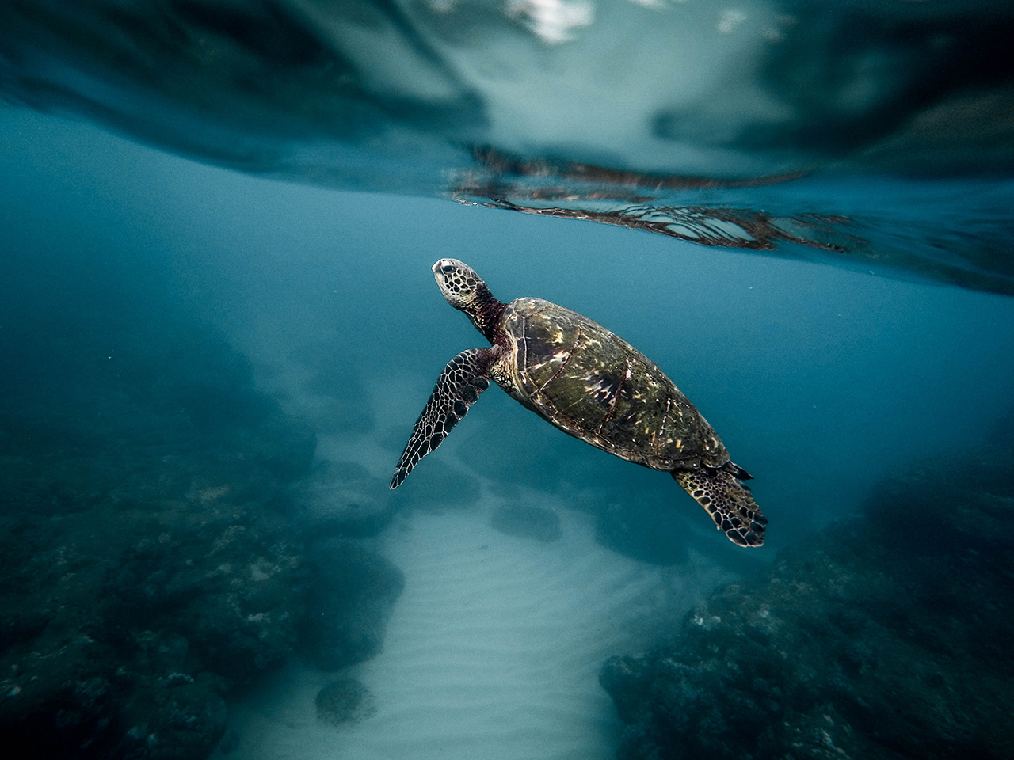
Endangered Species
An Ocean of Plastic

Slide 2
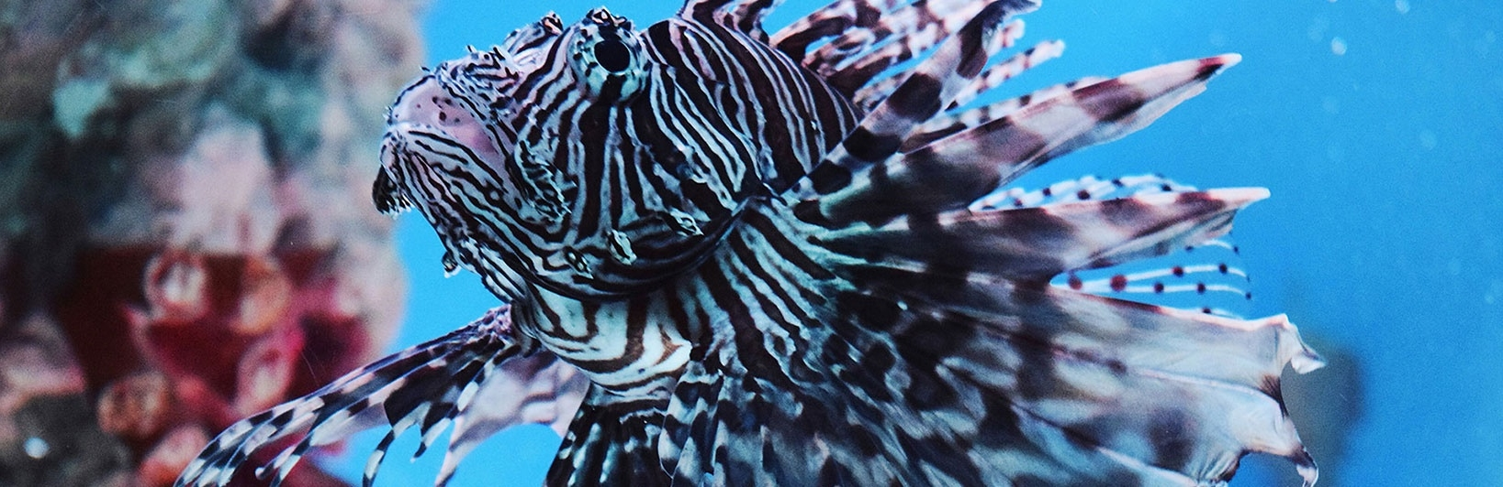
Scorpion Fish
Do Not Touch!

Slide 3
Scorpion Fish
Venomous Spines
Warning Signals
Waving Fins
Beaming Colours
Can penetrate wet suit

Slide 4
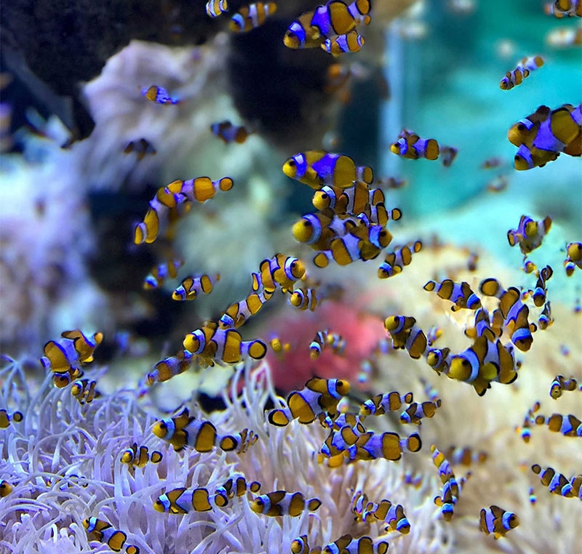
Brittle fish
Harmless
Protected by coral habitat
Do not approach
Sharp teeth
4

Slide 5
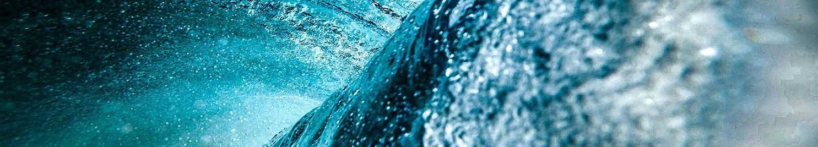
Mediterranean Fish Stocks
Endangered or dangerous fish
5

Slide 6
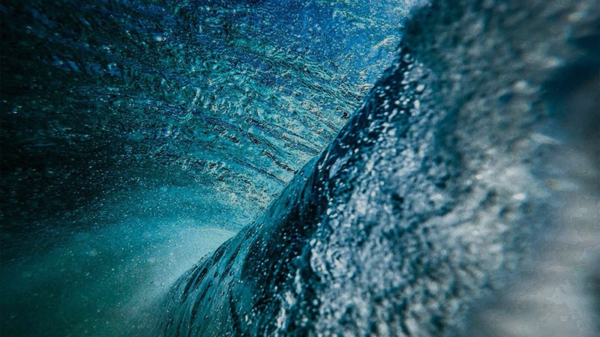
Section Title 2
Subtitle
6

Slide 7
Jacques Cousteau
Great underwater explorer
Partly responsible for invention of SCUBA
Author
Boatman
Over 20,000 dives
Unknown terrain and conditions
Paved the way for recreational diving

Slide 8
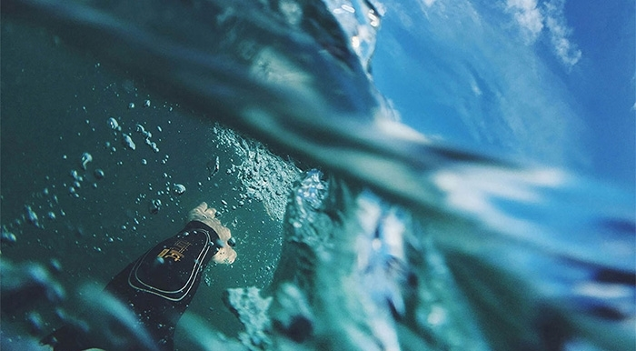
Jacques Quote
“
Diving into the blue provides freedom of the spirit
Jacques Cousteau 1937
“
8

Slide 9
Money For Conservation
Category | 2011 | 2112 | 2013 | 2014
Top Predators | 13000000 | 15000000 | 19000000 | 16000000
Shale | 345000 | 389000 | 410000 | 430000
Pelagics | 34000000 | 43000000 | 56000000 | 46000000
Bottom Dwelling | 1250000 | 178900 | 231000 | 193000

Slide 10
THANK YOU
Insert Image

